Slide 1

How to become a member of ASTM International F24 Committee on Amusement Rides and Devices
Please follow this step-by-step guide to become an ASTM member.

Slide 2
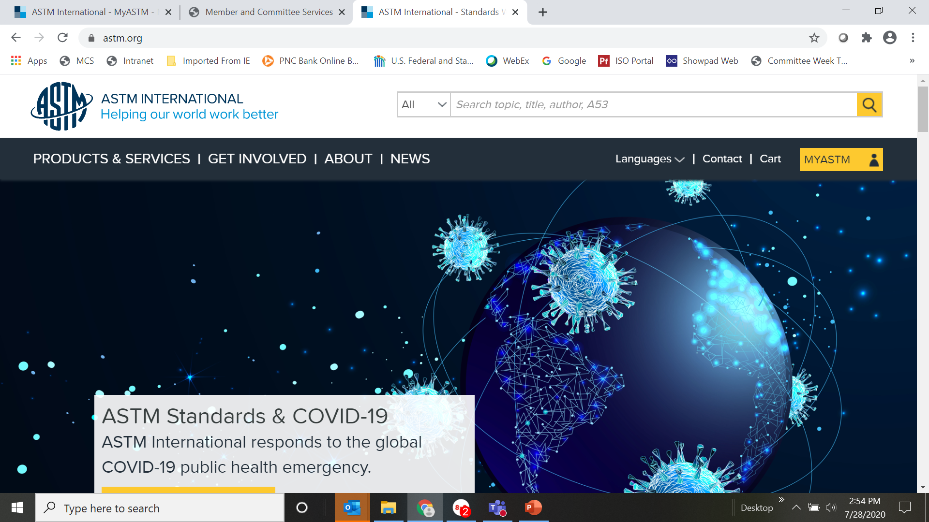
Go to www.astm.org

Slide 3
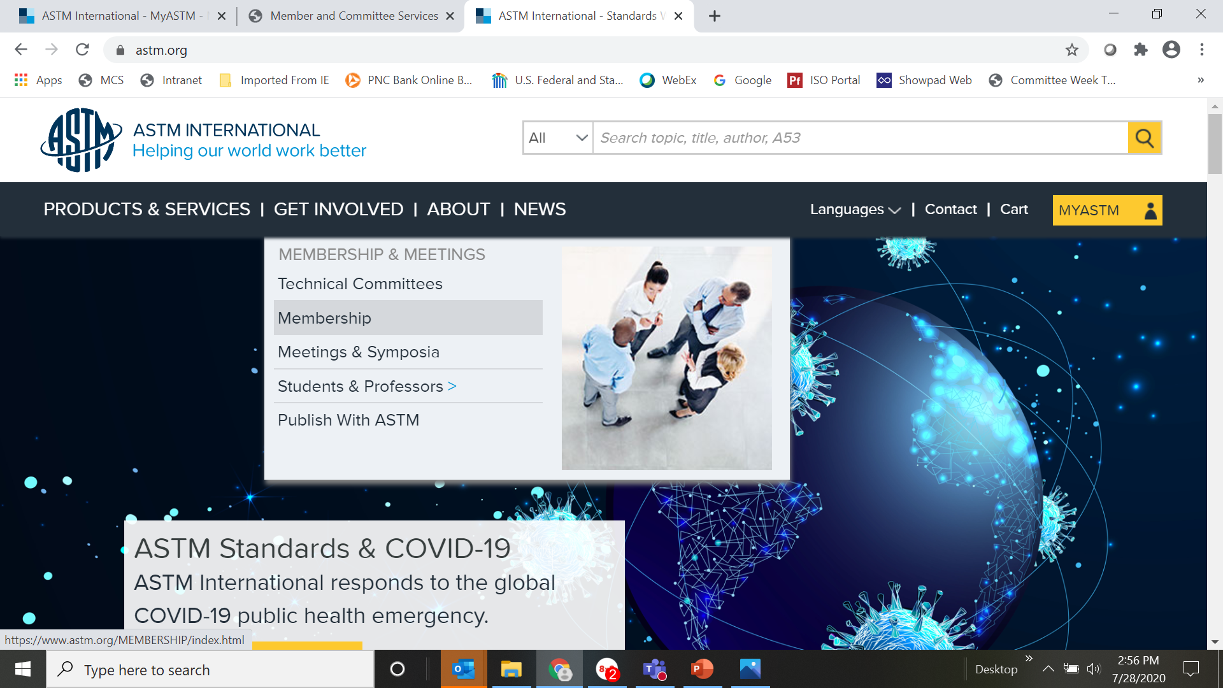
Click on “Get Involved” and then select “Membership”.

Slide 4
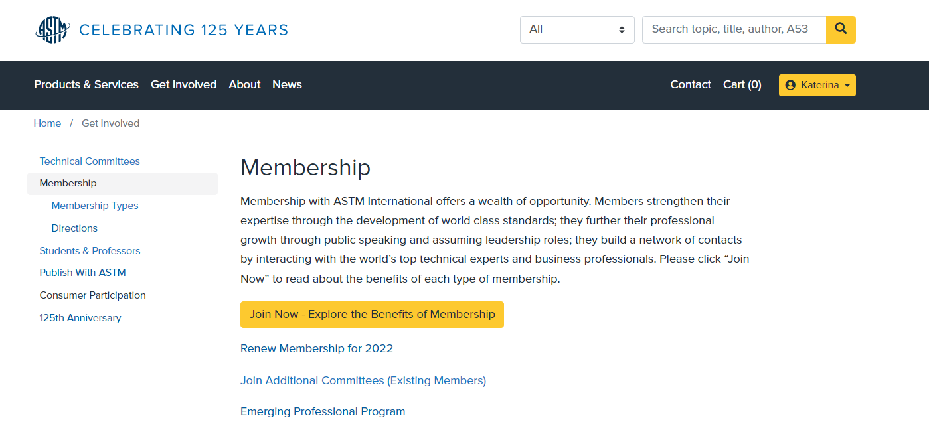
Click on “Join Now”.

Slide 5
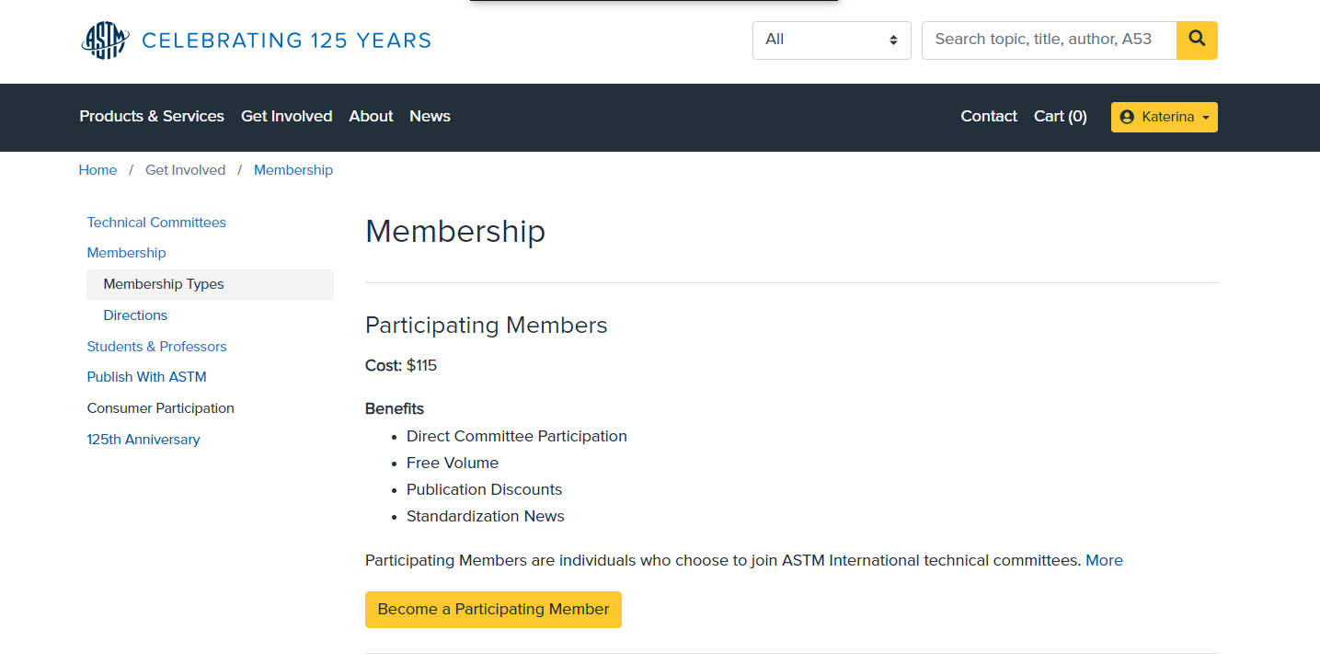
You can select the type of membership you prefer. Most ASTM members are participating members.

Slide 6
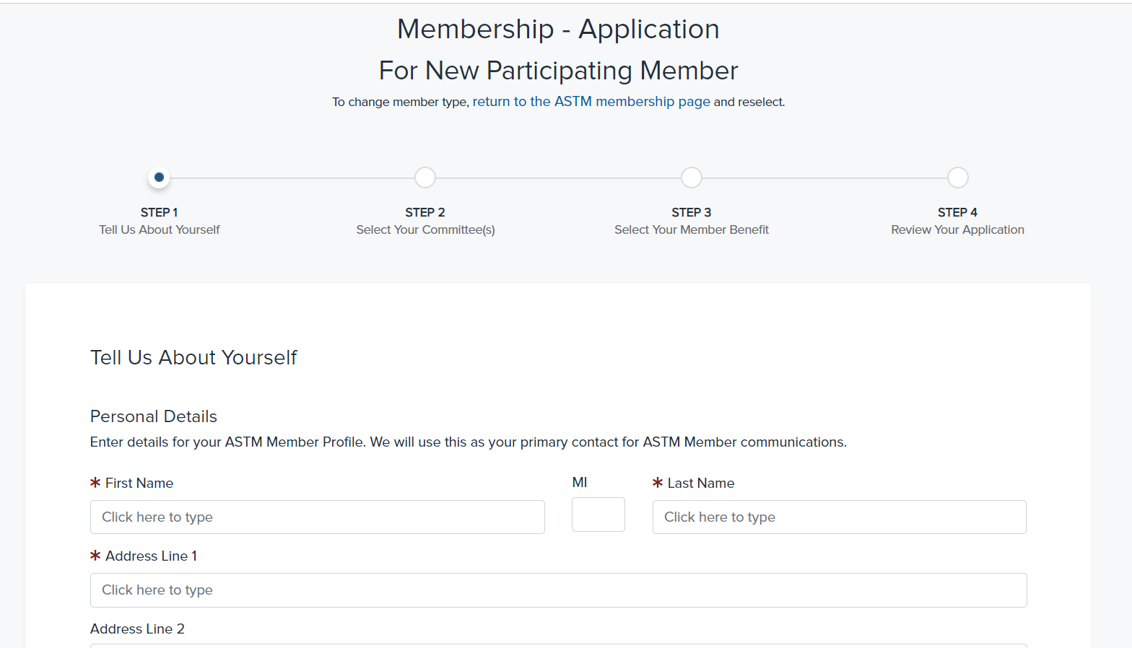
From this page just fill in all your personal/business details

Slide 7
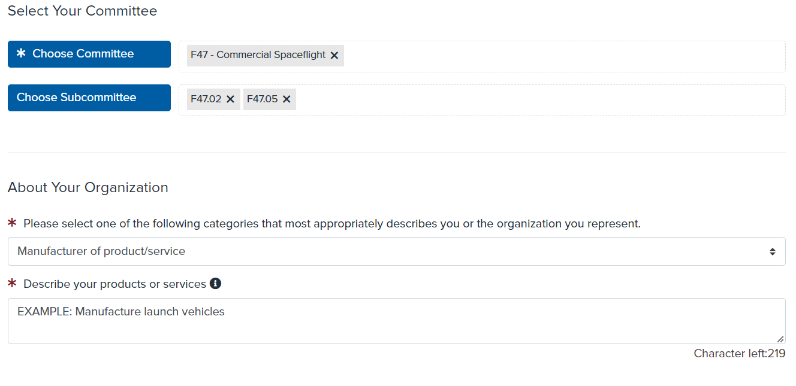
Select F24 and any sub-committees you’re interested in (keep in mind you can add/remove subs at any time once you’re a member). And then select what type of company you’re representing.
F24 on Amusement Rides and Devices X
F24.24 Design, Manufacture, Installation and commissioning X
******It is important that you fill this in accurately as this is how
the committee will classify you.
Notes:
F24 Sub-Committees:
F24.10 Test Methods and Component Parts
F24.20 Specifications and Terminology
F24.24 Design, Manufacture, Installation and commissioning
F24.30 Maintenance and Inspection
F24.40 Operation
F24.60 Special Rides/Attractions
F24.61 Adventure Attractions
F24.65 Parasailing
F24.70 Water Related Amusement Rides and Devices
F24.80 Harmonization
******All committees must be balanced meaning the number of producers can never outweigh the number of users, general interest, and consumers combined.******

Slide 8
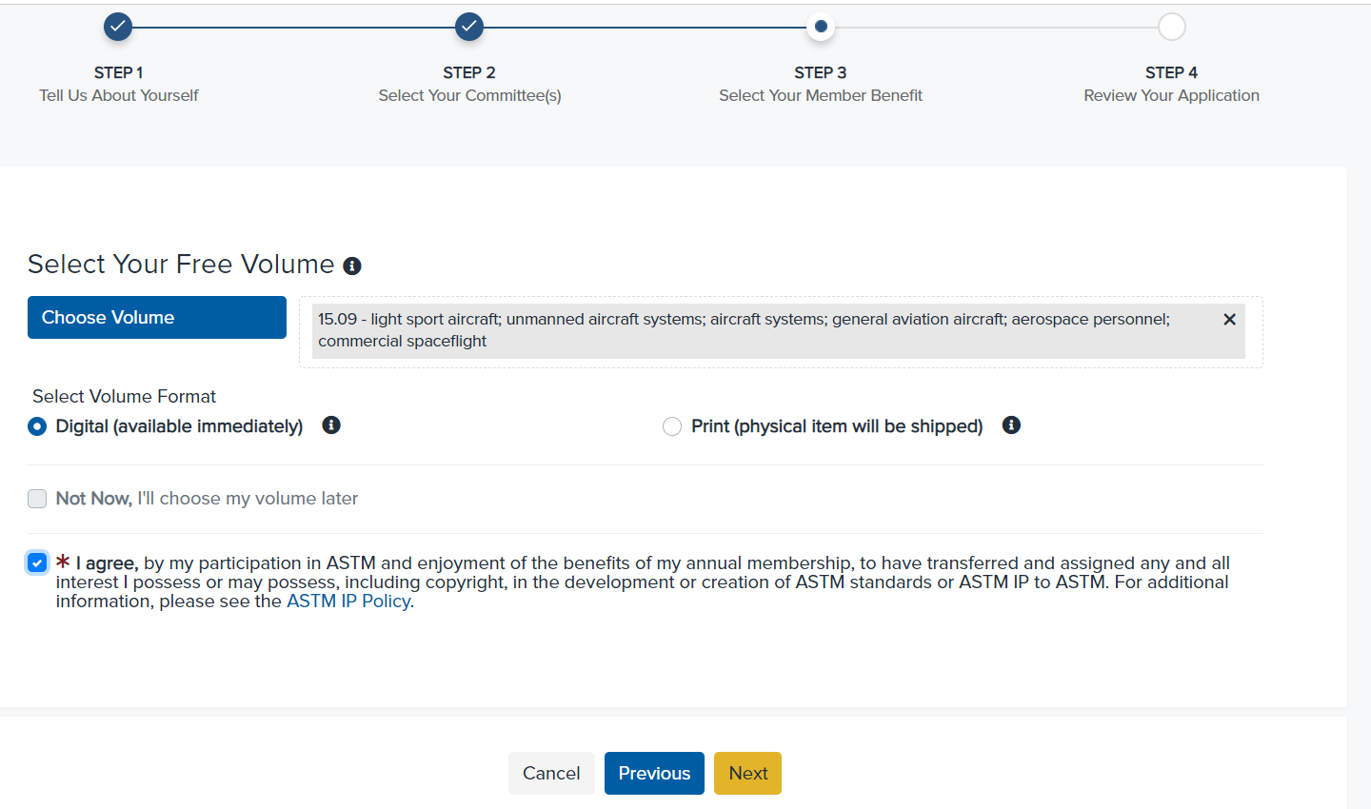
Please fill-in additional information about yourself.
F24 standards are in volume 15.07

Slide 9
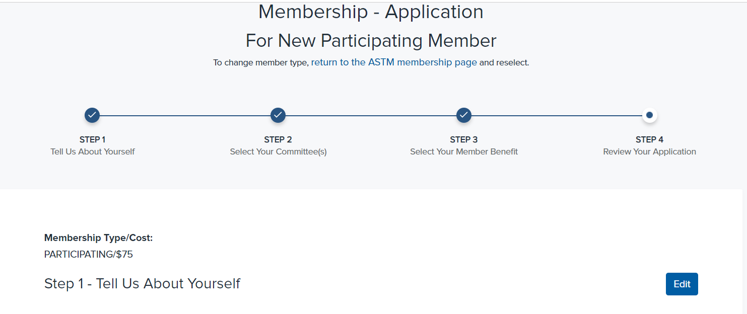
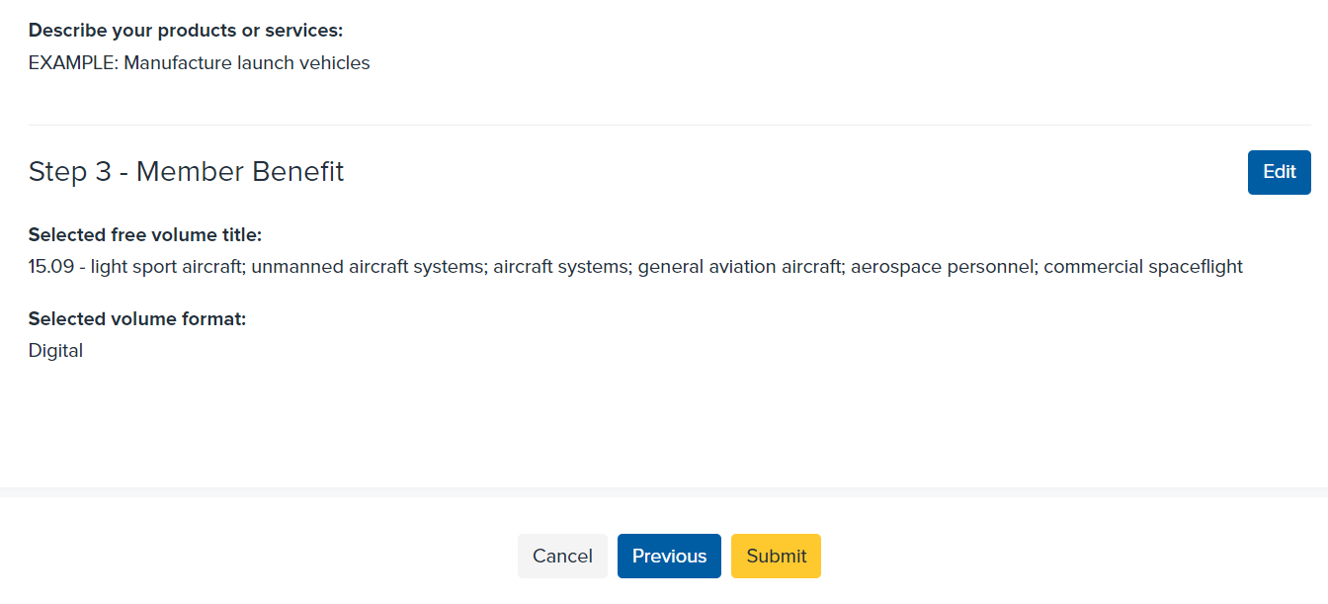
Complete your membership application by reviewing all the information you submitted and checking out.

Slide 10
If you have any problems during this process, please contact our customer service department at 610-832-9555.
Questions specific to F24 – Katerina Koperna
kkoperna@astm.org
Thank You!

